Slide 1
Nexus
An artifact repository and the Everis way of doing...

Slide 2
What’s an Artifact Repository Manager
Stores build artifacts
Retrieves build artifacts
Examples:
Maven: https://mvnrepository.com
Nuget: https://www.nuget.org
Npm: https://www.npmjs.com
Multiple: https://www.sonatype.com/nexus-repository-sonatype

Slide 3


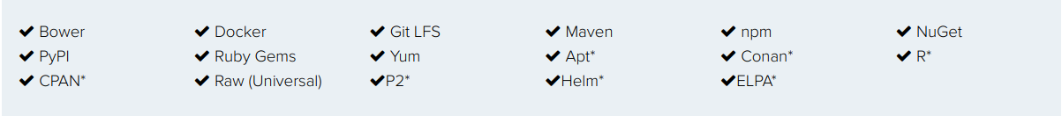
What’s Nexus
Proxy
Hosted
It’s a repository manager (not only artifact)
Install/Hire
Host/Proxy
* Available from the Nexus Exchange Community

Slide 4
Install Nexus
docker run -d -p 8081:8081 --name nexus sonatype/nexus3

Slide 5
How to ask for a new everis repo
Go to JIRA https://steps.everis.com/jiraproy/secure/Dashboard.jspa
Take the excel template from here https://steps.everis.com/confluence/pages/viewpage.action?pageId=775716887
Fill in the fields

Slide 6
Snapshot - Release
Released artifacts are considered to be solid, stable, and perpetual in order to guarantee that builds which depend upon them are repeatable over time. Can’t be overwritten.
Snapshots capture a work in progress and are used during development. Can be overwritten.

Slide 7
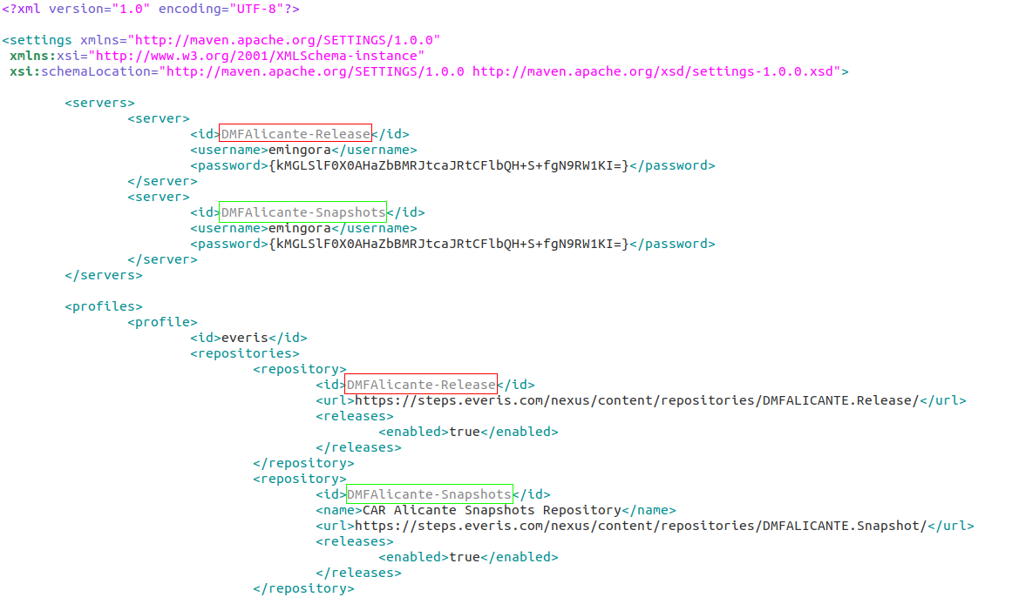
How to upload artifacts - Maven
Define the repo in the settings.xml
Mi recommendation it’s always to put it in the ~/.m2 folder
mvn deploy -DrepositoryId=DMFAlicante-Snapshots

Slide 8
How to upload artifacts - npm
Define registry in the ~/.npmrc
npm publish
How to generate the _auth
echo -n 'username:password' | openssl base64
base64Encode(<username>:<password>)
btoa(‘username:password’)
registry=[REGISTRY_URL] // to be replaced
always-auth=true
_auth="[AUTH]" // to be replaced
email=[EMAIL] // to be replaced
@angular:registry=https://registry.npmjs.org/
@schematics:registry=https://registry.npmjs.org/
@angular-devkit:registry=https://registry.npmjs.org/
@ngtools:registry=https://registry.npmjs.org/
@stomp:registry=https://registry.npmjs.org/
@types:registry=https://registry.npmjs.org/
@ngx-translate:registry=https://registry.npmjs.org/
@nicky-lenaers:registry=https://registry.npmjs.org/
@tweenjs:registry=https://registry.npmjs.org/
@toverux:registry=https://registry.npmjs.org/
@covalent:registry=https://registry.npmjs.org/
registry.npmjs.org/:_authToken=[NPMJS_AUTH_TOKEN] // to be replaced
proxy=[PROXY_URL] // to be replaced
https-proxy=[PROXY_URL] // to be replaced

Slide 9
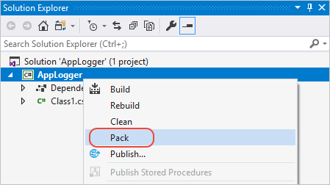
How to upload artifacts - nuget
nuget setApiKey <your_API_key>
nuget push YourPackage.nupkg -Source https://api.nuget.org/v3/index.json

Slide 10
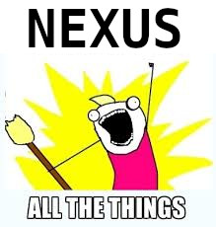
Gracias! preguntas?
Sources:
http://www.vogella.com/tutorials/Nexus/article.html
https://hub.docker.com/r/sonatype/nexus3
https://dzone.com/refcardz/getting-started-repository?chapter=1#refcard-download-social-buttons-display
https://docs.microsoft.com/es-es/nuget/quickstart/create-and-publish-a-package-using-visual-studio
Enrique Mingorance Cano
Center Expert Specialist, HPC Alicante
ginxo
emingora@everis.com

